Slide 1

Apache Curator Harshith Gowda

Slide 2
Agenda
Introduction
Features
Use cases

Slide 3
Introduction
Apache Curator is a Java/JVM client library for Apache ZooKeeper, a distributed coordination service. It also includes recipes for common use cases and extensions such as service discovery and a Java 8 asynchronous DSL.

Slide 4
Features
Automatic connection management
Cleaner API
Recipe implementations
Automatic connection management:
There are potential error cases that require Zookeeper clients to recreate a connection and/or retry operations.
Curator automatically and transparently (mostly) handles these cases.
Watches for NodeDataChanged events and calls updateServerList() as needed.
Watches are automatically removed by Curator recipes
Cleaner API:
Simplifies the raw ZooKeeper methods, events, etc.
provides a modern, fluent interface.

Slide 5
Recipe implementations :
Leader election
Shared lock
Path cache and watcher
Distributed Queue
Distributed Priority Queue

Slide 6
Leader Election
Leader Election is a complex process when it is done from scratch. But ZooKeeper service makes it very simple.
Consider there are N number of nodes in a cluster. The process of leader election is as follows −
All the nodes create a sequential, ephemeral znode with the same path, /app/leader_election/guid_.
ZooKeeper ensemble will append the 10-digit sequence number to the path and the znode created will be /app/leader_election/guid_0000000001, /app/leader_election/guid_0000000002, etc.
For a given instance, the node which creates the smallest number in the znode becomes the leader and all the other nodes are followers.
Each follower node watches the znode having the next smallest number. For example, the node which creates znode /app/leader_election/guid_0000000008 will watch the znode /app/leader_election/guid_0000000007 and the node which creates the znode /app/leader_election/guid_0000000007 will watch the znode /app/leader_election/guid_0000000006.
If the leader goes down, then its corresponding znode /app/leader_electionN gets deleted.
The next in line follower node will get the notification through watcher about the leader removal.
The next in line follower node will check if there are other znodes with the smallest number. If none, then it will assume the role of the leader. Otherwise, it finds the node which created the znode with the smallest number as leader.
Similarly, all other follower nodes elect the node which created the znode with the smallest number as leader.

Slide 7
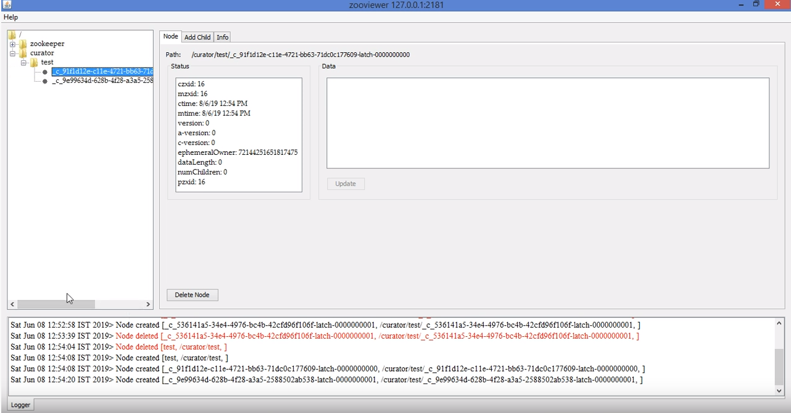
Leader Election

Slide 8
Shared Lock
Shared locks exist when two transactions are granted read access.
One transaction gets the shared lock on data and when the second transaction requests the same data it is also given a shared lock.
Both transactions are in a read-only mode, updating the data is not allowed until the shared lock is released.
There is no conflict with the shared lock because nothing is being updated.
Shared locks last as long as they need to last; it depends on the level of the transaction that holds the lock.
Shared locks gives data access more efficiency, and increases the lock managers overhead because the type of lock must be known before a lock can be granted, three types of lock operations exist: READ_LOCK, WRITE_LOCK, UNLOCK, and the schema is enhanced to allow a lock upgrade and downgrade.

Slide 9
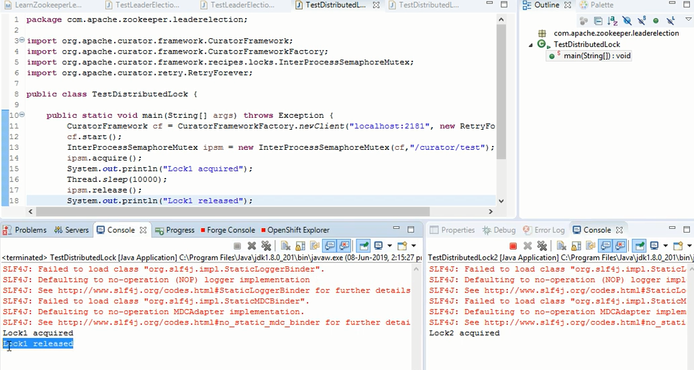
Shared Lock

Slide 10
Path cache and watcher
A Path Cache is used to watch a ZNode. Whenever a child is added, updated or removed, the Path Cache will change its state to contain the current set of children, the children's data and the children's state.
Participating Classes are :
PathChildrenCache
PathChildrenCacheEvent
PathChildrenCacheListener
ChildData
The cache must be started by calling start(). Call close() when you are through with the cache.
There are two versions of start(). The no-arg version gives default behavior.
The other version takes an enumeration that allows you to control how the initial cache is warmed.

Slide 11
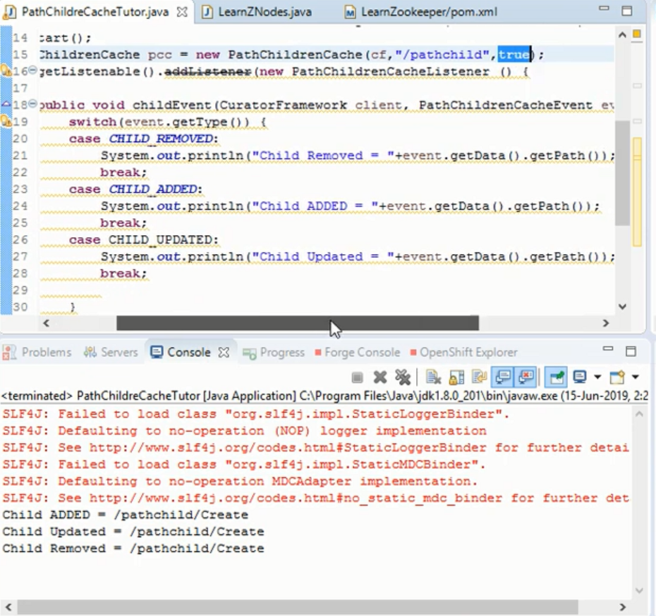
Path cache and watcher

Slide 12
Distributed Queue
A Distributed Queues are allow you to retrieve a connection to any of the Queues across a cluster by using the Global JNDI name.
Items put into the queue are guaranteed to be ordered (by means of ZK's PERSISTENTSEQUENTIAL node).
If a single consumer takes items out of the queue, they will be ordered FIFO. If ordering is important, use a Leader Selector to nominate a single consumer.
It seems one of the main pieces of functionality Distributed Queue gives you is load-balanced connections across multiple managed servers.
The members of the unit are usually distributed across multiple servers within a cluster, with each queue member belonging to a separate JMS server.
A distributed queue is a set of physical JMS queue members.

Slide 13
Distributed Priority Queue
Priority Queue:
Every item has a priority associated with it. An element with high priority is dequeued before an element with low priority.
If two elements have the same priority, they are served according to their order in the queue.
Distributed Priority Queue:
It determines the minimum number of items from the active list that will get processed before a refresh.
Due to a quirk in the way ZooKeeper notifies changes, the queue will get an item addition/remove notification after every item is processed. This can lead to poor performance.

Slide 14
Use cases
1. Naming service
2. Configuration management
3. Synchronization
4. Leader election
5. Message Queue
6. Notification system

Slide 15
Thank You

